Slide 1

Topic:
Project on Depth First Search
The Maze
Practical Applications of Algorithms(CS501)
Guided by
Dr.Henry Chang

Slide 2

Table of Contents
Introduction
Design
Implementation
Test
Enhancement Ideas
Conclusion
Bibliography

Slide 3
Introduction
Depth-first traversal (DFS) is a method for exploring a tree or graph.
In a DFS, you go as deep as possible down one path before backing up and trying a different one. Depth-first search is like walking through a corn maze. You explore one path, hit a dead end, and go back and try a different one
Uses:
Depth-first search is used in topological sorting, scheduling problems, cycle detection in graphs, and solving puzzles with only one solution, such as a maze or a sudoku puzzle

Slide 4
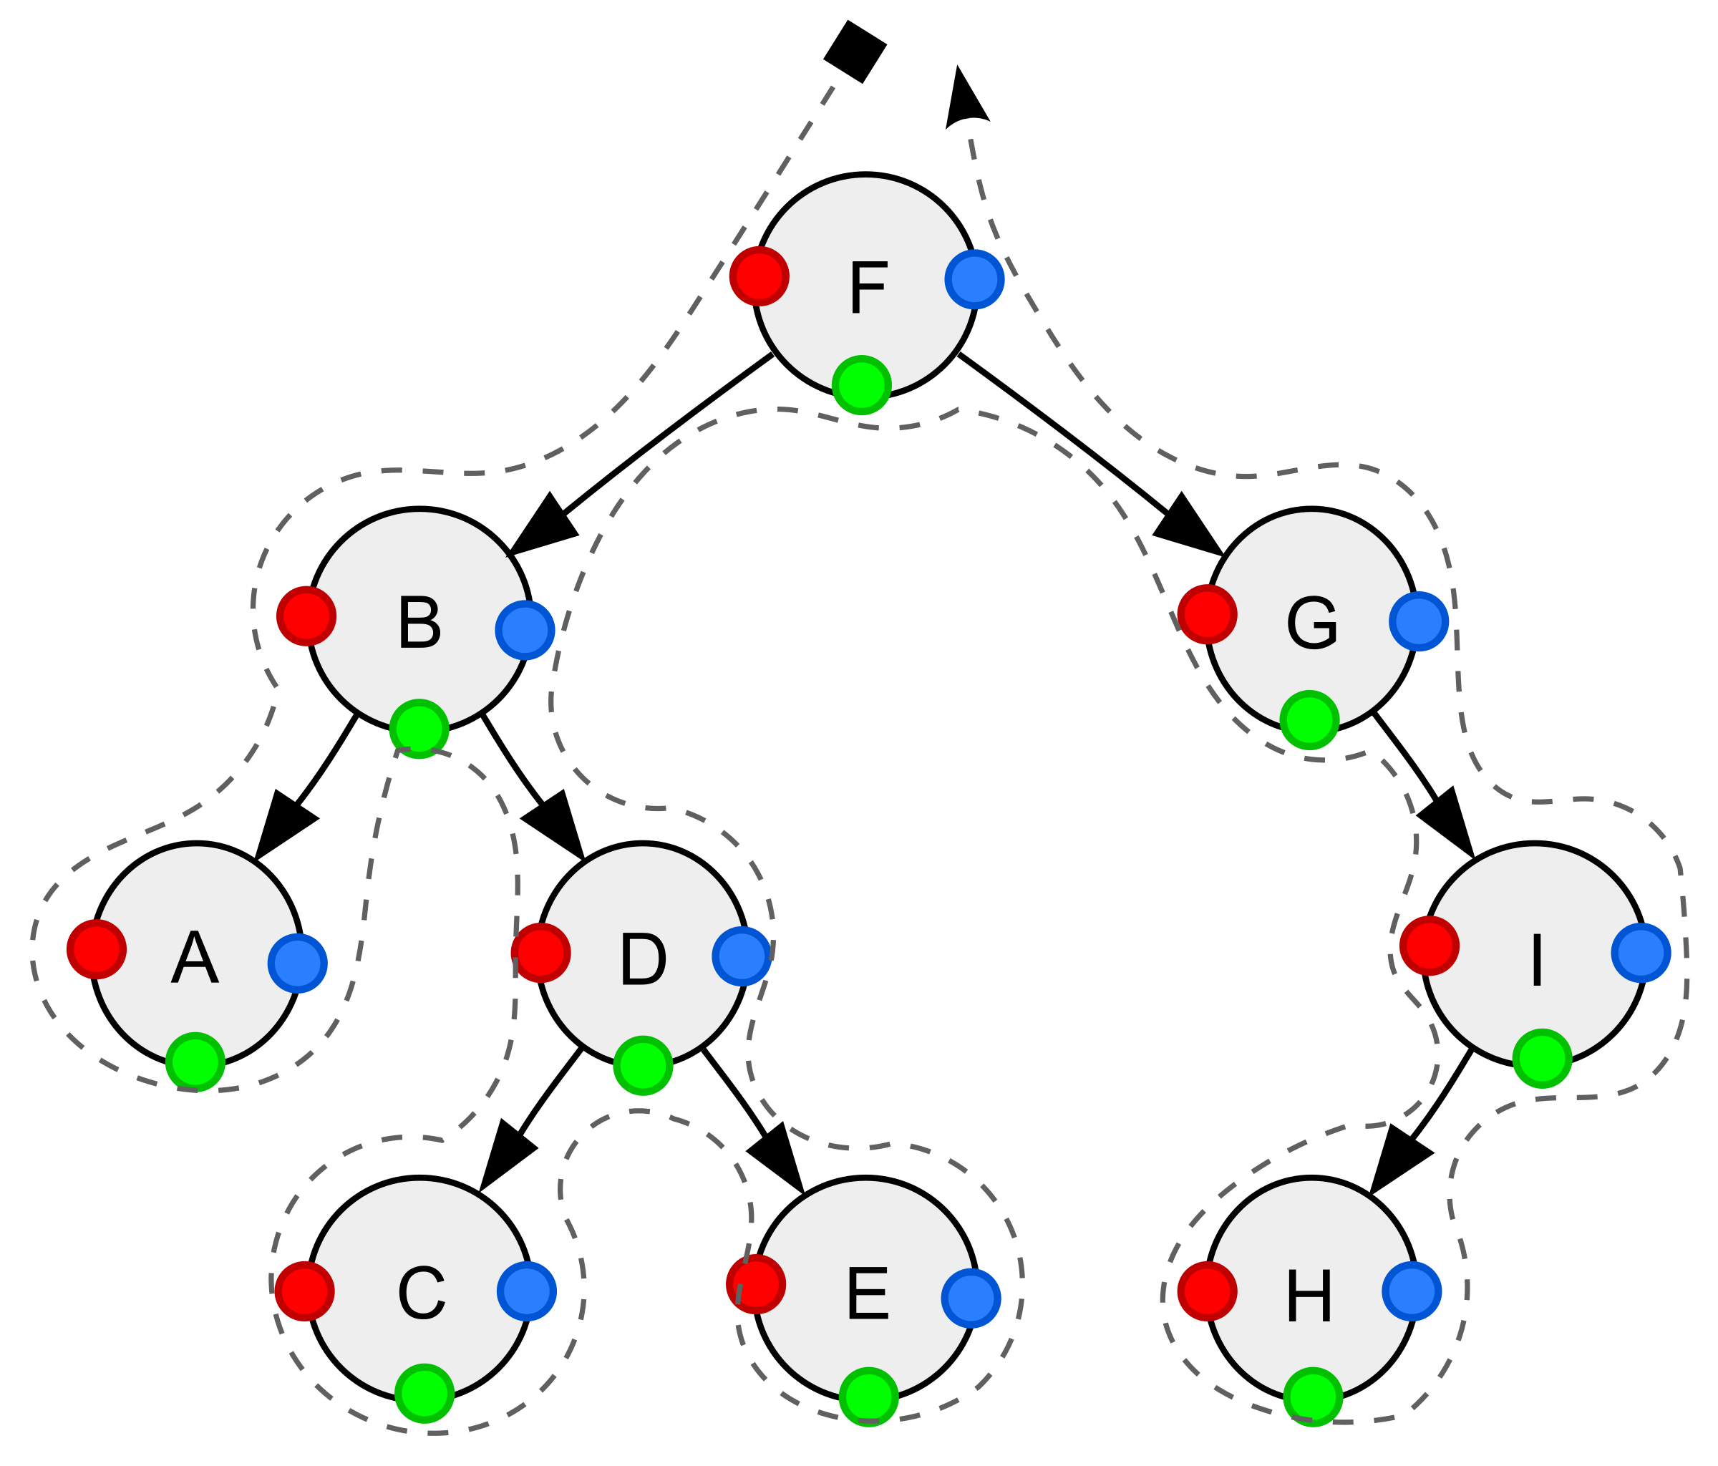
Design
Approach:
Depth-first search is an algorithm for traversing or searching tree or graph data structures.
The algorithm starts at the root node and explores as far as possible along each branch before backtracking.
So the basic idea is to start from the root or any arbitrary node and mark the node and move to the adjacent unmarked node and continue this loop until there is no unmarked adjacent node.
Then backtrack and check for other unmarked nodes and traverse them. Finally, print the nodes in the path.

Slide 5
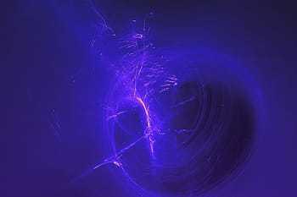
Algorithm:
Create a recursive function that takes the index of the node and a visited array.
Mark the current node as visited and print the node.
Traverse all the adjacent and nodes that are unmarked which calls the recursive function with the index of the adjacent node.
In this traversal algorithm, it will first try a path, then keep going deep until it reaches a dead-end or it finds the final destination which is the solution.
If it encounters a dead end, we will fall back to the previous point.

Slide 6

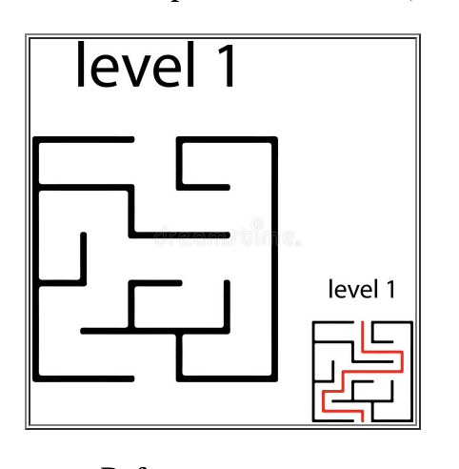
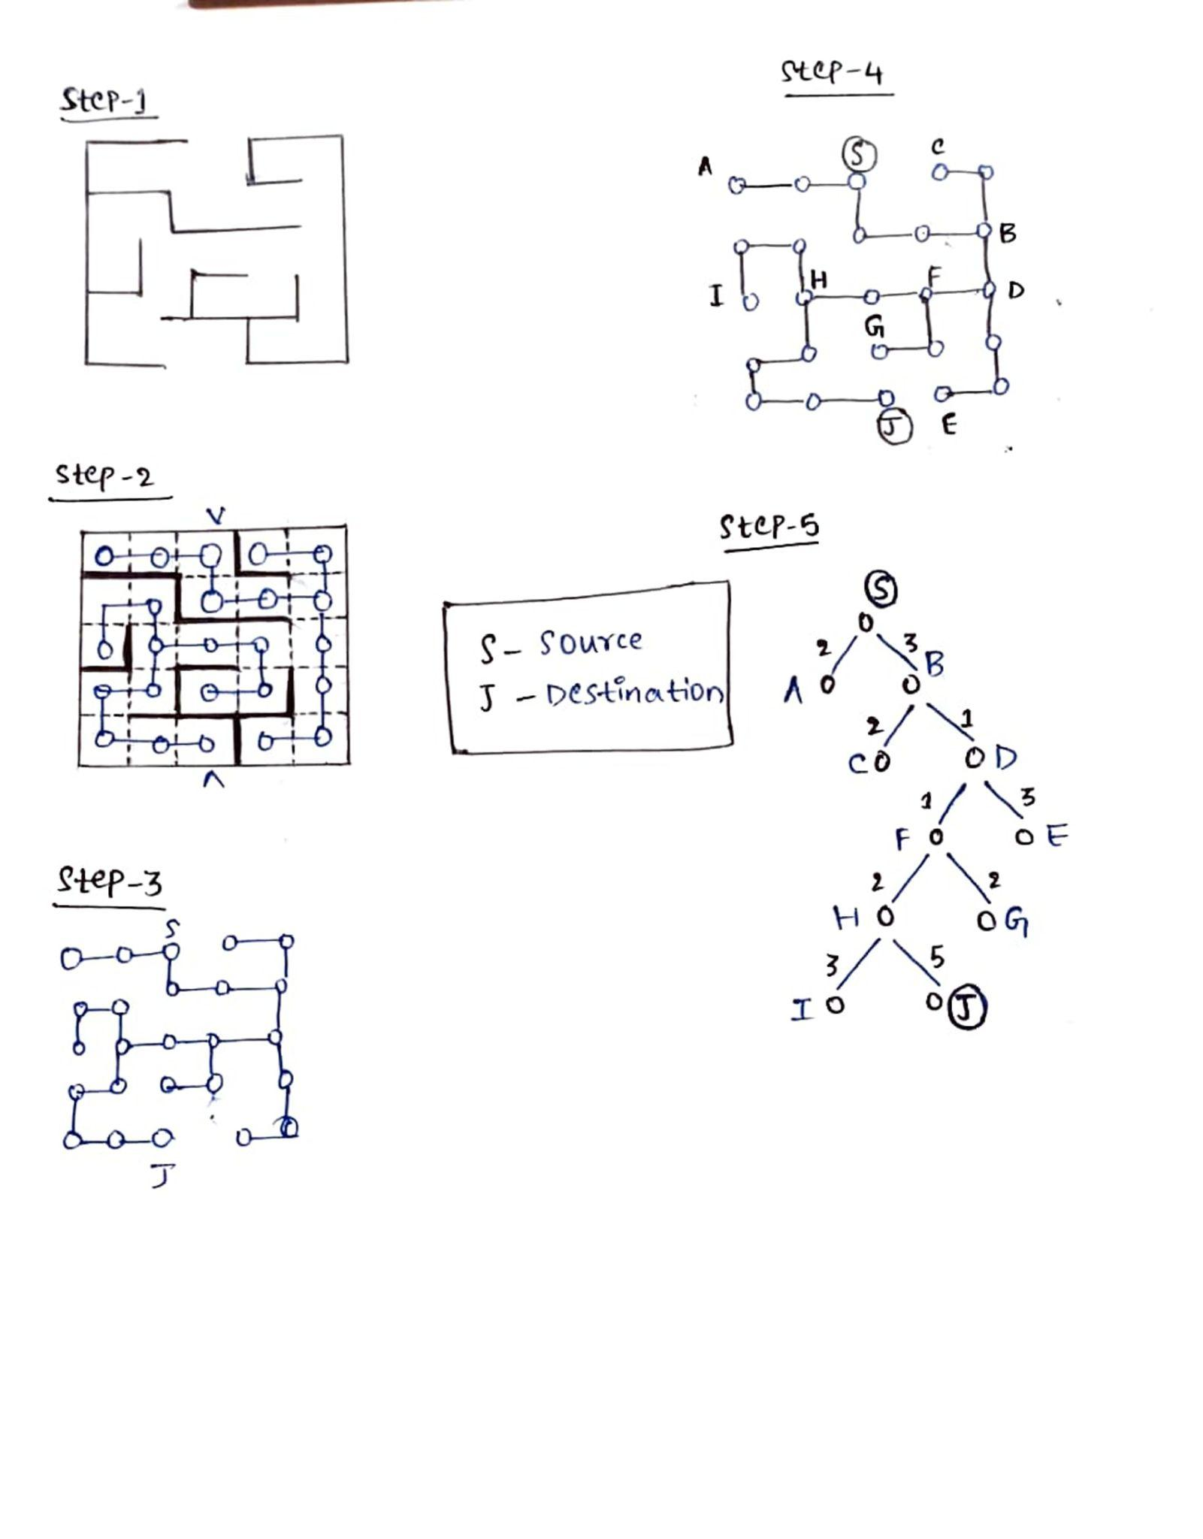
Solution to Clear Route (Street, Highway) Tree
Step 1.1: Tree Approach to Depth-First Traversal to manually solve the problem Maze example

Slide 7

Approach : Depth First Search
We can view the given search space in the form of a tree.
The root node of the tree represents the starting position.
Four different routes are possible from each position i.e. right, left, up or down.
These four options can be represented by 4 branches of each node in the given tree.
Thus, the new node reached from the root traversing over the branch represents the new position occupied by the ball after choosing the corresponding direction of travel.

Slide 8
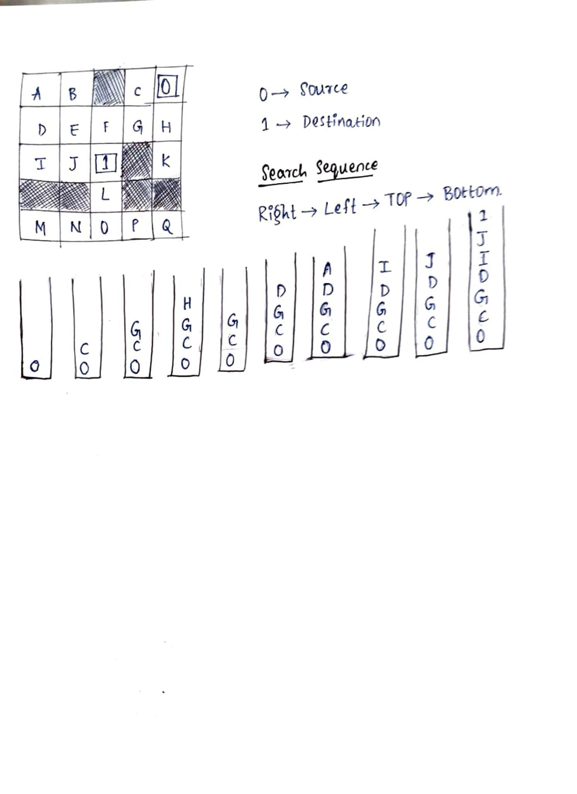
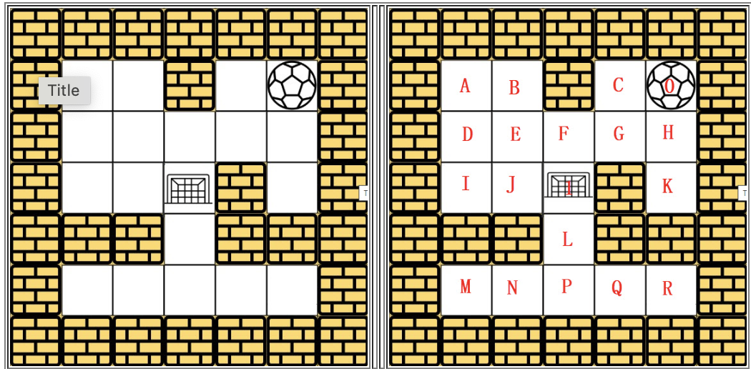
Step 1.2: Matrix Approach to Depth-First Traversal to manually solve the problem Maze example
Unclear Route (Hotel, Hospital) Martrx

Slide 9
Best Approach:
The best approach is the Matrix because the time complexity of this approach is O ( V + E ) O(V + E) O(V+E) and the space complexity O(bm)
Where as the time complexity of the tree approach is time complexity of O(m + n) and space complexity is O(n).

Slide 10
Solving Maze Problems:
For all maze problems, a very simple idea can be used to solve the problem, that is, traverse.
We can start from the starting point.
First, determine whether the current point is the existing point.
If it is, it means we have found the end; if it is not, then we need to continue the traverse.
Then go to its right point. And repeat step 1
Then go to its below point. And repeat step 1.Then go to its left point. And repeat step 1.
Then go to its above point. And repeat step 1.

Slide 11
Applications:
Finding all pair shortest path in an undirected graph.
Detecting cycle in a graph.
Path finding.
Topological Sort.
Testing if a graph is bipartite.
Finding Strongly Connected Component.
Solving puzzles with one solution.

Slide 12
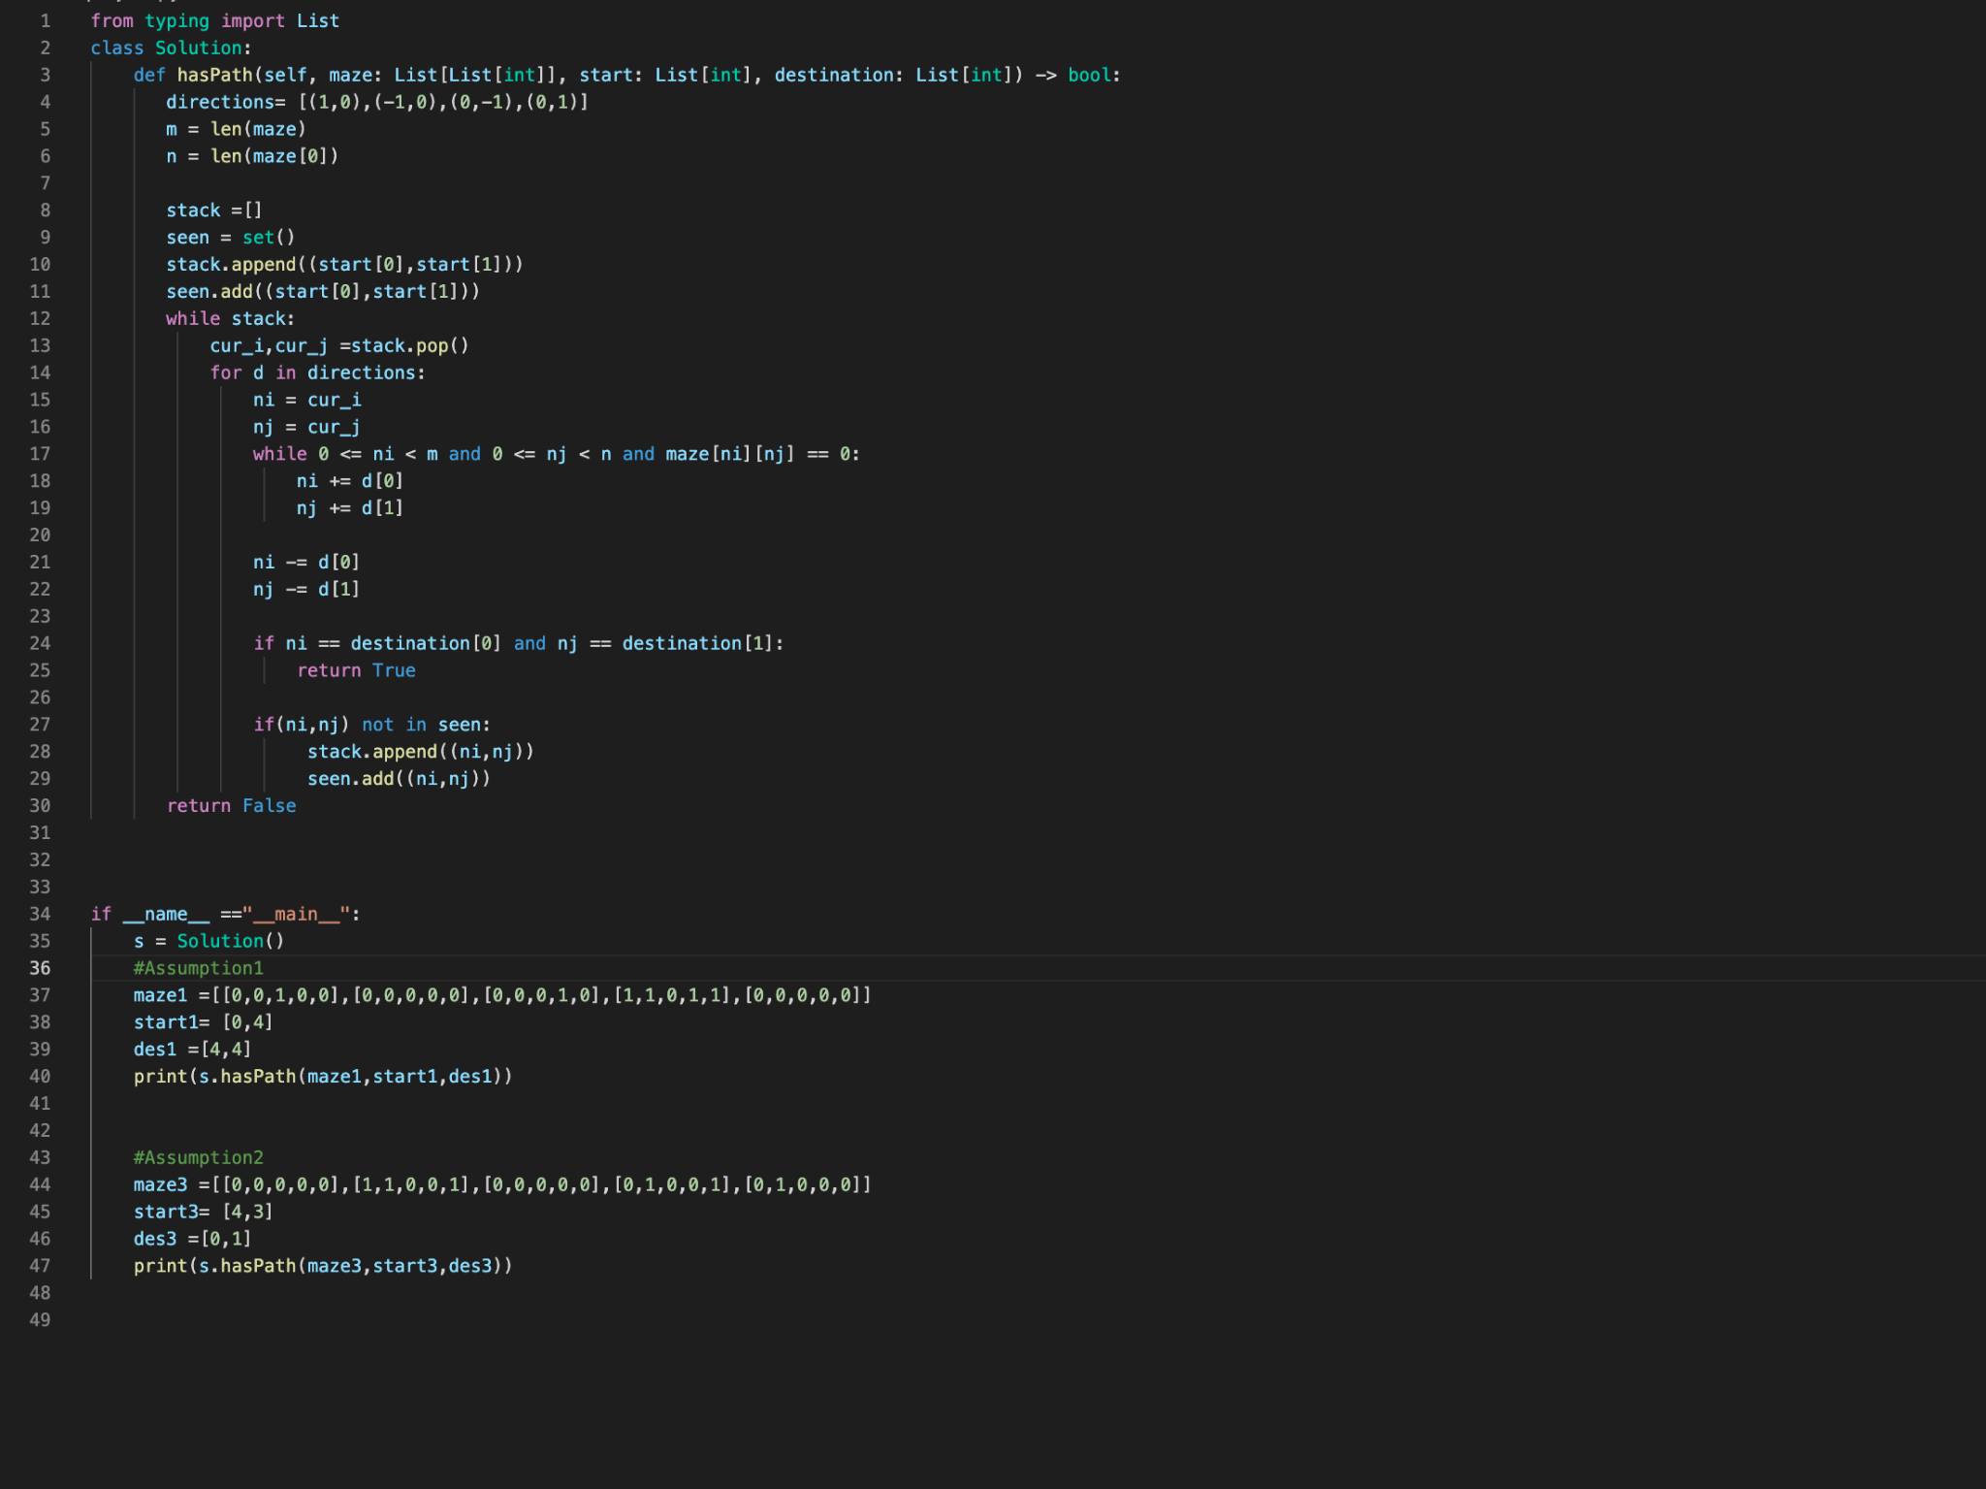
Python Implementation

Slide 13
Test

Slide 14
Enhancement Ideas:
We can improve the performance of DFS by eliminating the cycles.
The technique, referred to as cycle checking, prevents the generation of duplicate nodes in the DFS search of a graph by comparing each newly generated node to the nodes already on the search path.
Full cycle checking compares a new node to all nodes on the path
Parent cycle checking merely compares a new node to the parent of the node being expanded.
Simple guidelines are presented showing which type of cycle checking should be used on a given problem.

Slide 15
Conclusion:
Depth-first search is often used as a subroutine in network flow algorithms such as the Ford-Fulkerson algorithm
DFS is also used as a subroutine in matching algorithms in graph theory such as the Hopcroft–Karp algorithm. Depth-first searches are used in mapping routes, scheduling, and finding spanning trees.

Slide 16
Bibliography:
Google
Leetcode
Articles like https://link.springer.com/article/10.1007/BF01389000
https://bytefish.medium.com/use-depth-first-search-algorithm-to-solve-a-maze-ae47758d48e7
studylib

